Slide 1
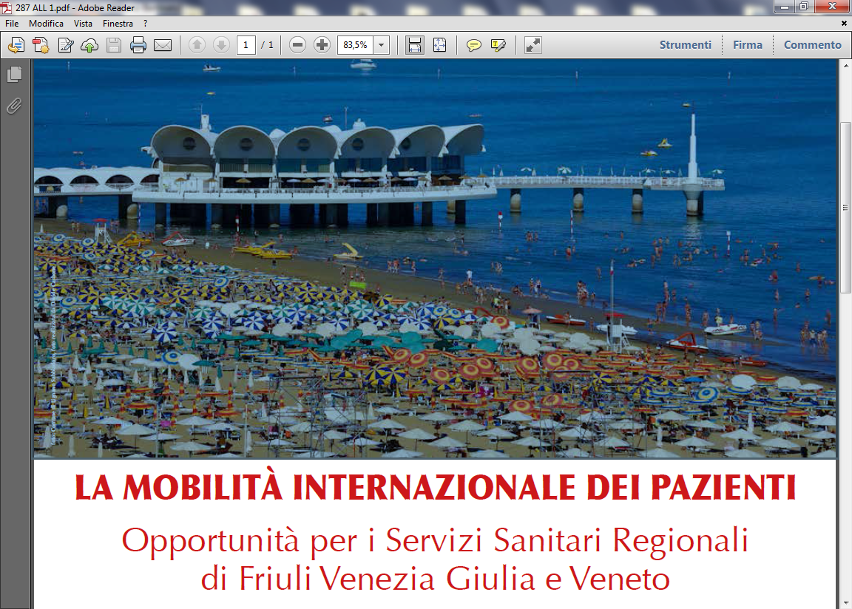

INTERNAZIONALiZZAZIONE DELLA SANITA’ ITALIANA
INTERNAZIONALIZZAZIONE E ACCORDI CON CASSE MUTUE RUSSE E AMERICANE: QUALI GLI STEP DA SEGUIRE E LE OPPORTUNITA’ PER LA SANITA’ PUBBLICA E PRIVATA
Le convenzioni con le Casse Mutue e le Compagnie Assicurative
Luigi Bertinato
Lignano , 7 Ottobre 2016

Slide 2
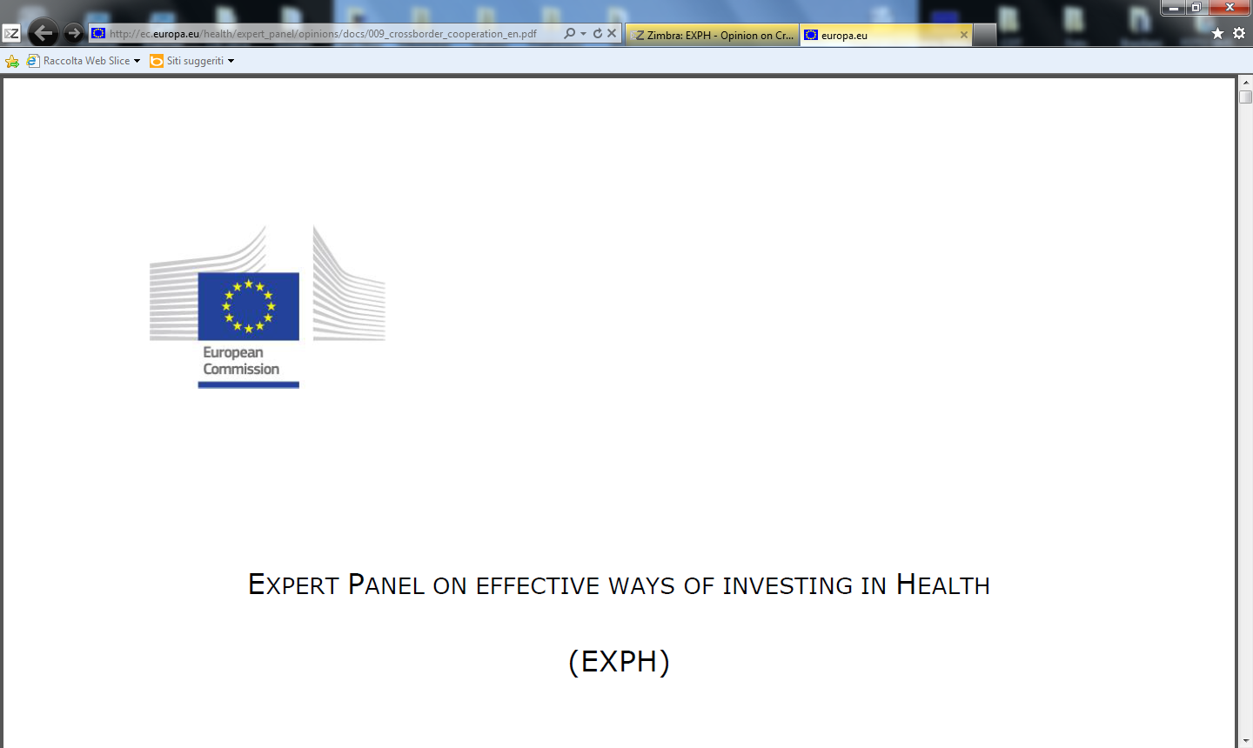
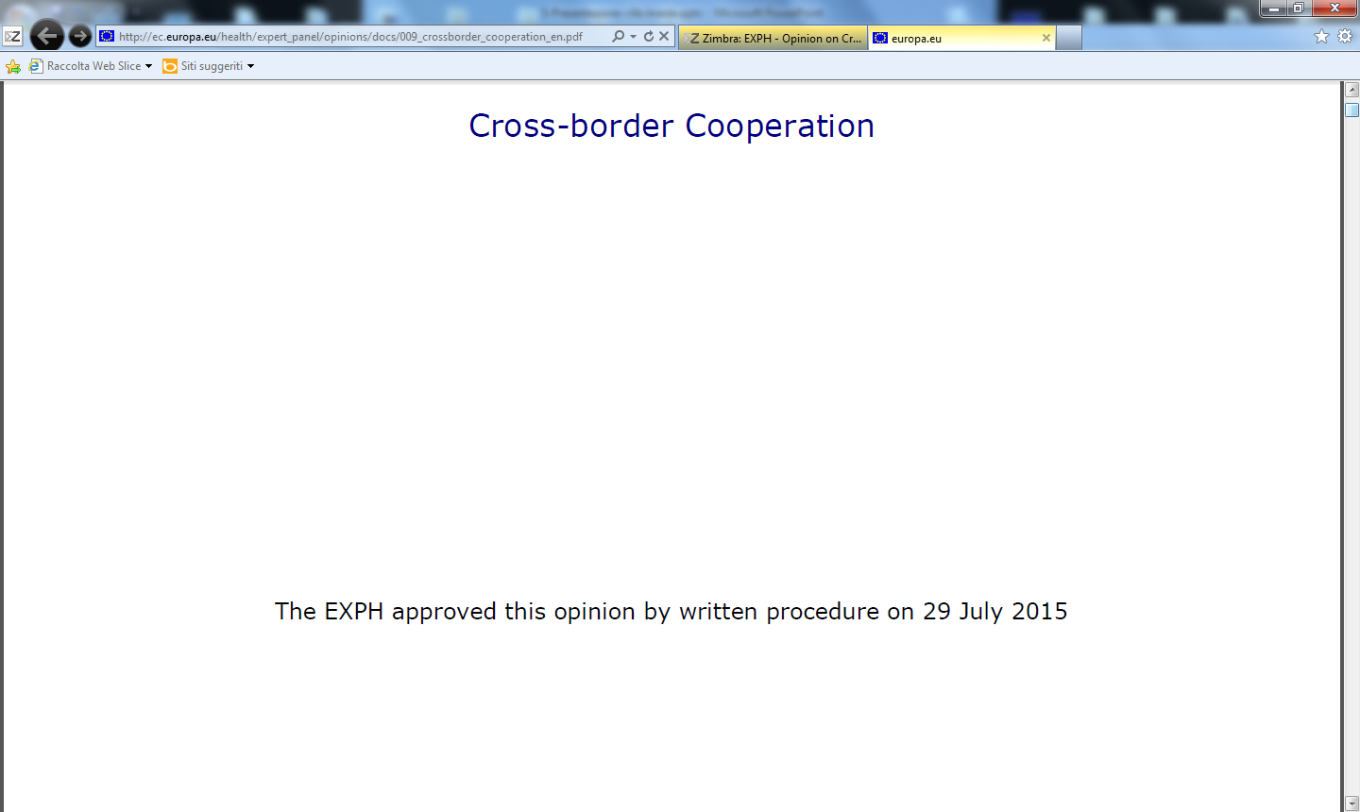
The opinion on Cross-border Cooperation has just been published on our website.
http://ec.europa.eu/health/expert_panel/opinions/docs/009_crossborder_cooperation_en.pdf

Slide 3
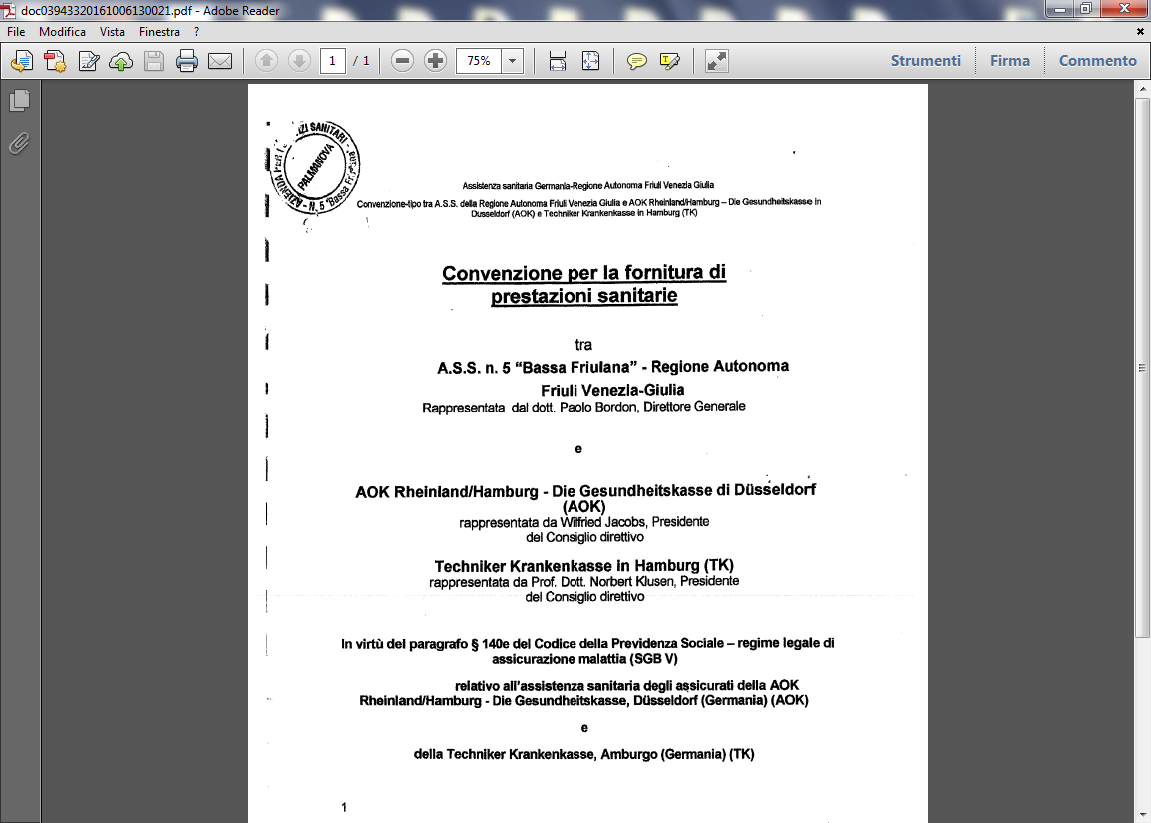

Slide 4
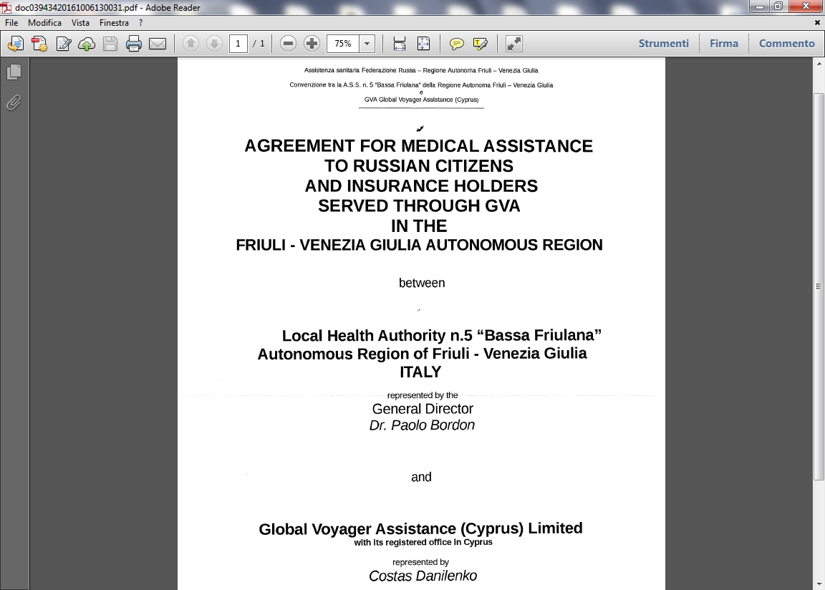

Slide 5

Domanda 1: Come valutare l’entrata in vigore degli accordi in essere con le casse mutue tedesche e con i Russi ?
Notes:
L.Bertinato-Palmanova 2011
5
L.Bertinato-Palmanova 2011
5

Slide 6
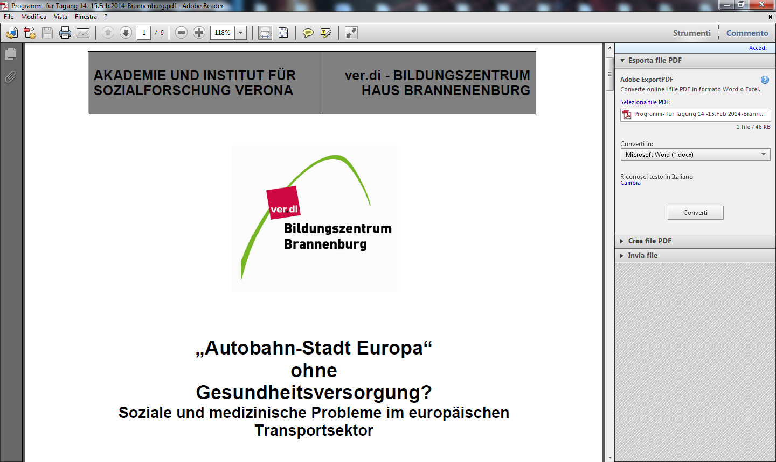

Slide 7
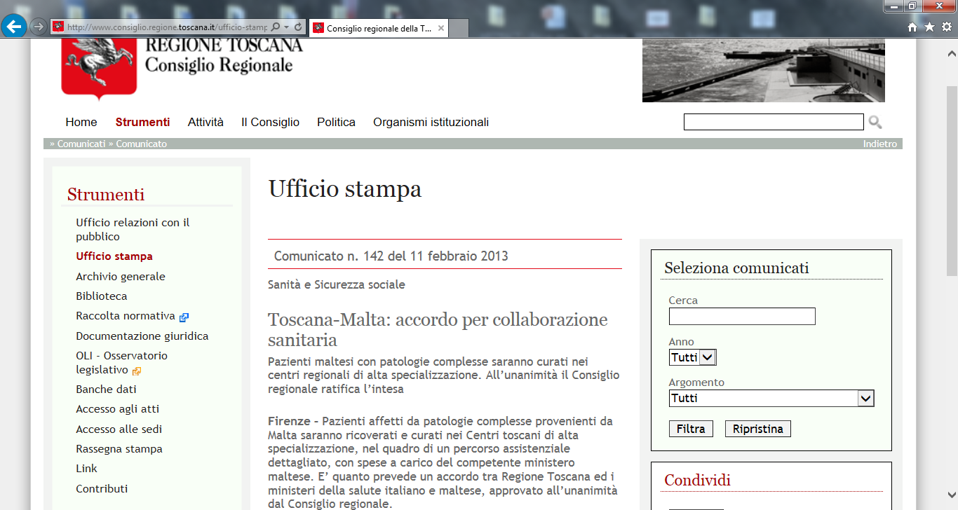

Slide 8
Domanda 2: Quali sono i nuovi bisogni assistenziali del paziente italiano/non italiano
nel 2016 ?
Notes:
L.Bertinato-Palmanova 2011
8
L.Bertinato-Palmanova 2011
8

Slide 9
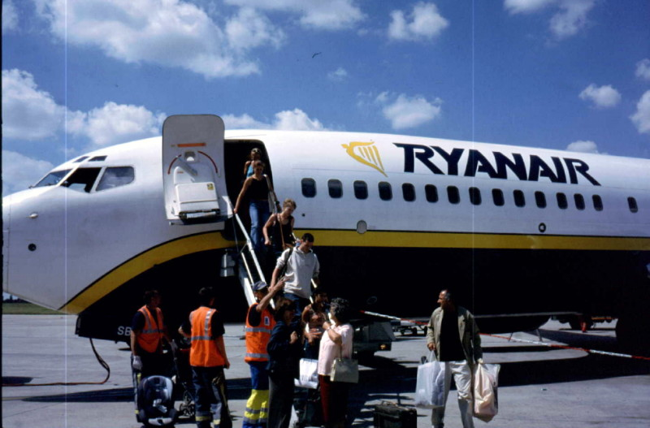
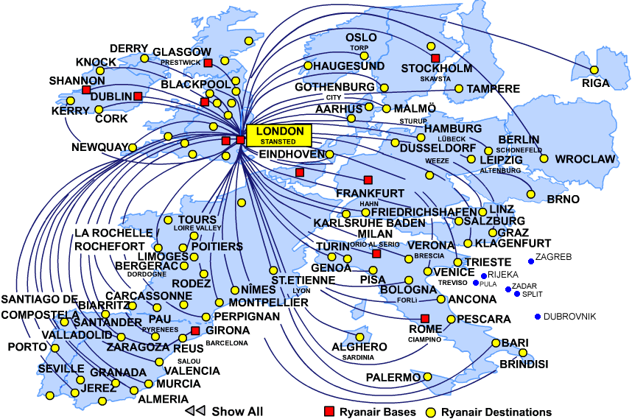
The “new” European Patients...
Courtesy: McKee/Zanon
L. Bertinato, 2016

Slide 10
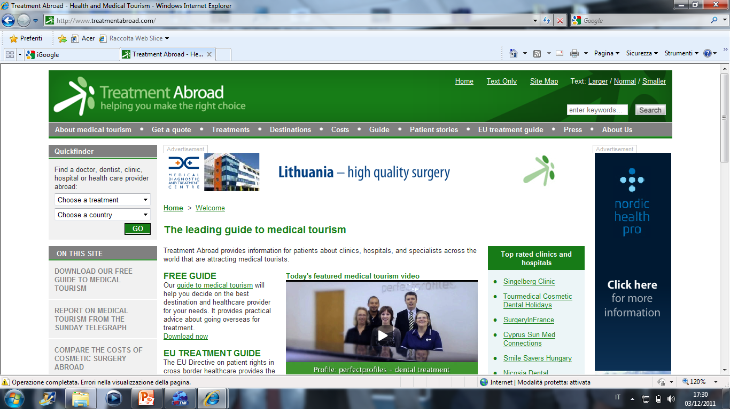
10
L. Bertinato 2011

Slide 11
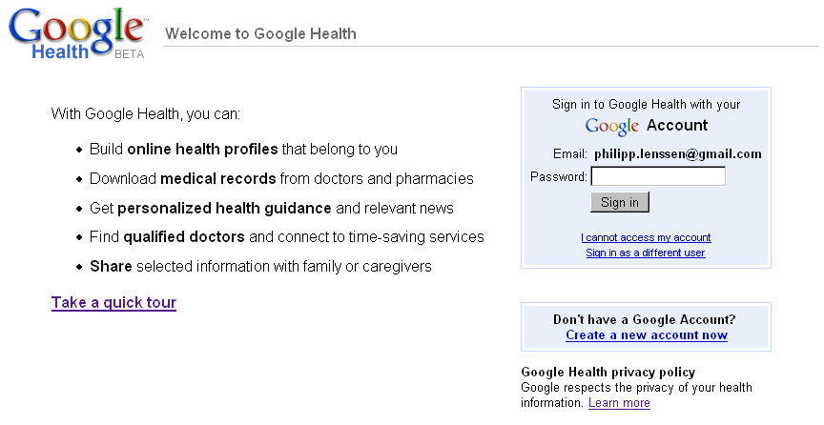
Dream or disaster?
Luigi Bertinato MD, Veneto Region – TEMOS 2009,
Notes:
L.Bertinato-Palmanova 2011
11

Slide 12
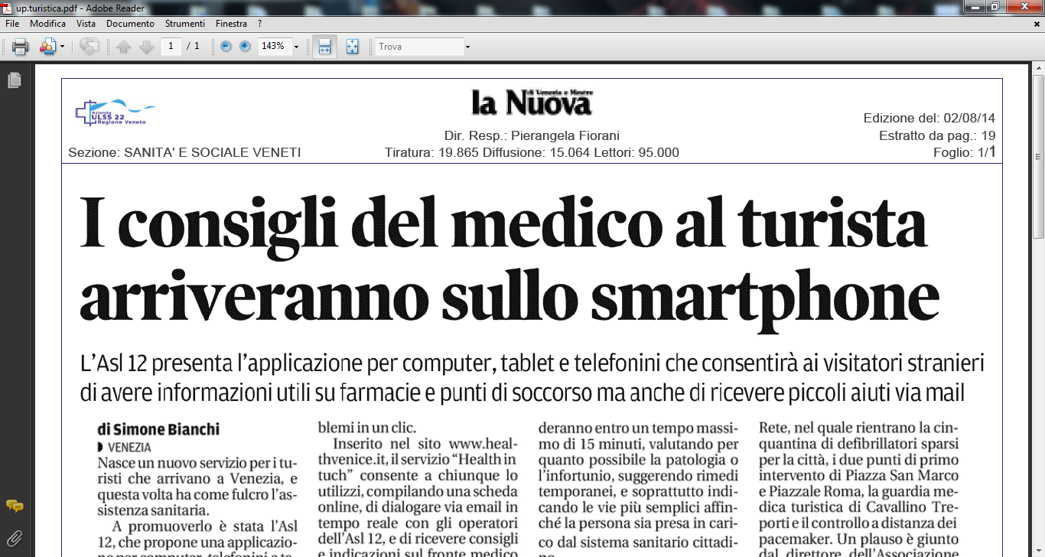

Slide 13
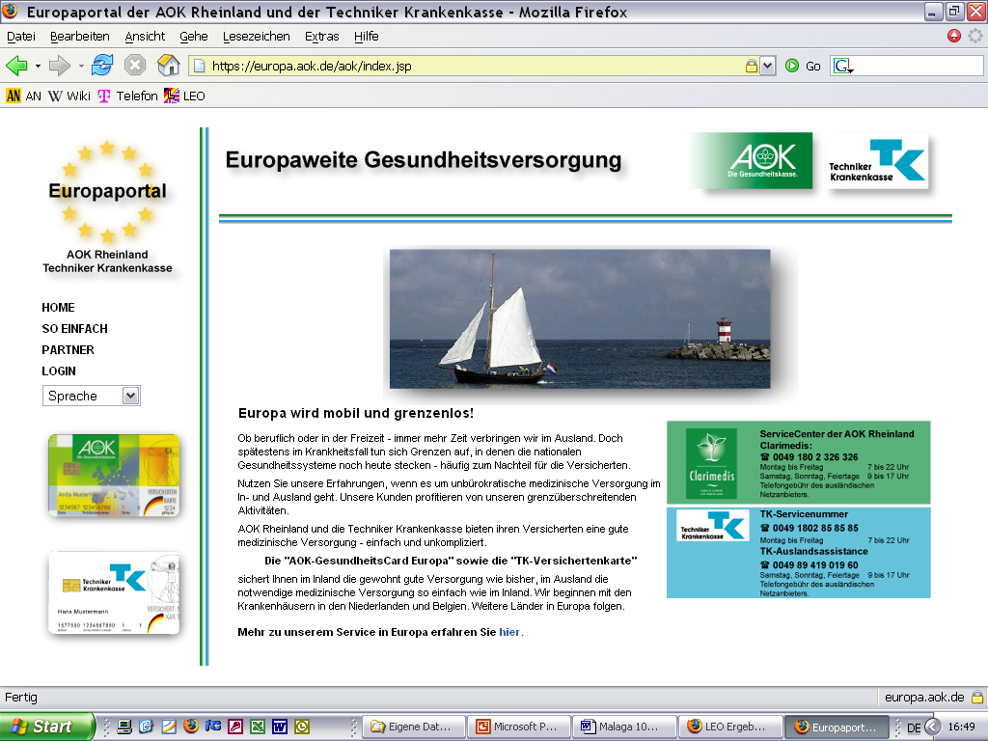
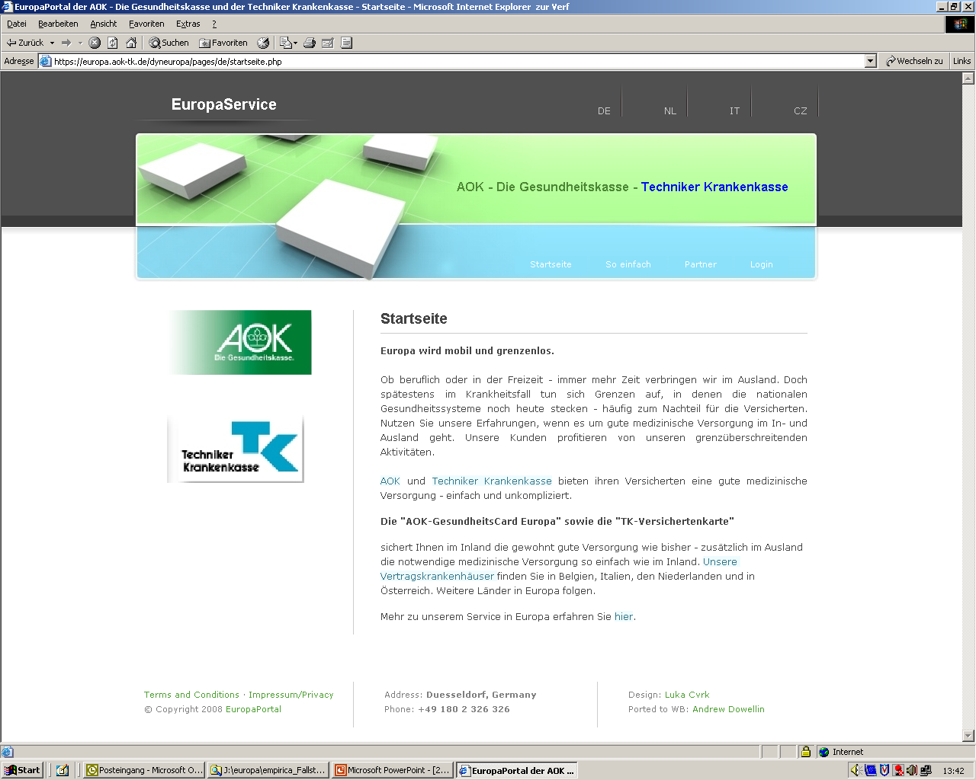

EuropePortal: EuropeService
EuropePortal – dynamic platform – customised to the specific national requirements
Europa.AOK-TK.de
Notes:
At the beginning of the project: The web-based interoperability platform, the EuropePortal and the EuropaServer, have been used in the Netherlands and in Belgium since 2002.
The latest development includes the development from a static to a dynamic platform of the EuropaPortal which offers a lot more flexibility in adapting the service to the different national requirements easing the process of adding
more languages -- more countries -- more hospitals –
more insurance companies
On that basis the EuropeService was developed and has become part of our service package which offers:
an information portal in different languages informing our patients
about the different health systems and requirements abroad
an online insurance status verification resulting in a written permission
for treatment for the health service provider
online billing and reimbursement
and a 24 hour hotline service
The Service Package with the Electronic Health insurance Card and the eEHIC has been certified by the TÜV Rheinland – a well-known certification body in Germany - as an add on service for insured citizens in need of health care treatment abroad in 2009.
Now Mr. Lahaye will present the EuropaPortal in his function.

Slide 14
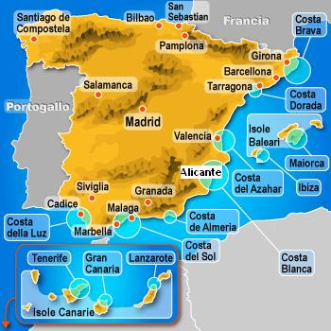

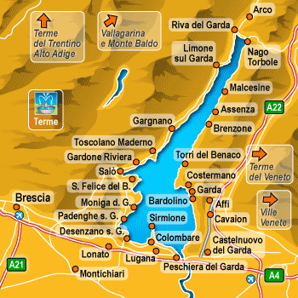
Aumento delle migrazioni di pensionati dal Nord Europa al Sud Europa durante la stagione invernale (800,000 stimati dall’UE ogni anno)
PORTOGALLO
L’Algarve
SPAGNA
Resort spagnoli
ITALIA, VENETO
Lago di Garda
3,500 residenti permanenti dal Nord Europa
Forte impatto sull’economia locale e forte impatto sul sistema sanitario locale
14
14
Notes:
L.Bertinato-Palmanova 2011
14
L.Bertinato-Palmanova 2011
14
Increasing migration of pensioners from Northern to Southern Europe during the winter season (800,000 estimated by the EU per annum)
Example: Spain as a destination
Valdemarsson & Malmström-Valdemarsson (2005) mention several reasons why people move to Spain, including a better climate, business opportunities, a yearning for something new, lower taxes, health reasons, lower living costs and lower house prices. Over the past decade, the traditionally homogeneous country has become a sort of open-door laboratory on immigration.
Spain has absorbed more than 3 million foreigners from places as diverse as Romania, Morocco, and South America.
More than 11% of the country's 44 million residents are now foreign-born, one of the highest proportions in Europe.
With hundreds of thousands more arriving each year, Spain could soon reach the U.S. rate of 12.9%.
CASE No. 6: 153/ 01 of 03.07.2003: VAN DER DUIN ONDERLINGE WAARBORGMAASTSCHAPPIJ ANOZ ZORG.
RETIRED PERSONS WHO ACQUIRE RESIDENCE IN ANOTHER MEMBER STATE OUTSIDE THEIR HOME COUNTRY MUST REQUEST AUTHORIZATION FROM THE HEALTH CARE SERVICE WITH WHICH THEY ARE REGISTERED TO BE ABLE TO RECEIVE MEDICAL CARE IN ANOTHER MEMBER STATE.
This principle also applies to pensioners who receive medical health care in the State which pays their pension or income.

Slide 15
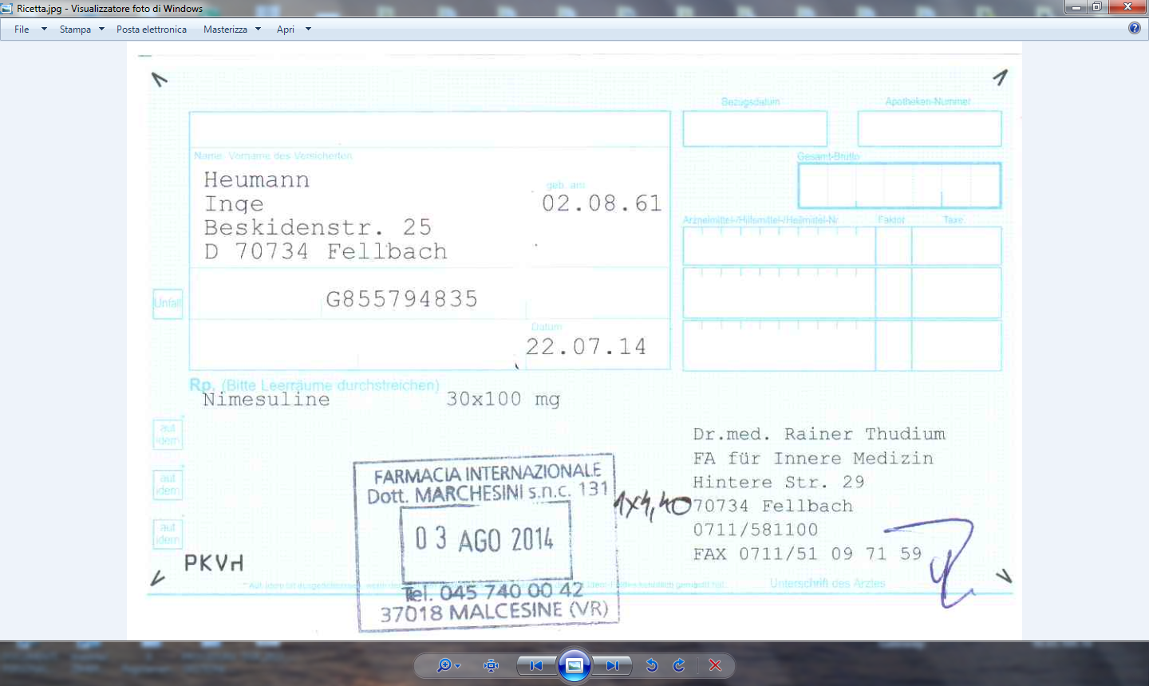

Slide 16
Domanda 3: In quali attività Internazionali siete attualmente coinvolti in ASL /Az.Osp?
Notes:
L.Bertinato-Palmanova 2011
16
L.Bertinato-Palmanova 2011
16

Slide 17


World Market of Medical Tourists (conservative figures)
Estimated minimal market size is between
5,1 Billion (Milliardi) €
and it is growing!
Without the estimations of the EU cross-border medical travel potential…
Italy`s current best estimated market share: 0,05 %
Which means: Italy is still absent
Italy`s easily achievable market share:
4,5 % = 207.000.000 €
17
Check www.IMTJonline.com, the best information source in medical tourism!
Notes:
17

Slide 18
Domanda 3: La mobilità internazionale dei pazienti: che sia una questione di cultura organizzativa della sanità regionale?
Notes:
L.Bertinato-Palmanova 2011
18
L.Bertinato-Palmanova 2011
18

Slide 19


Accordi transfrontalieri tra strutture sanitarie di Paesi diversi dalla UE
Sono già in vigore con risultati positivi in vari Stati
Garantiscono un sistema chiaro e funzionante al cittadino/paziente
L. Bertinato 2016

Slide 20
Antonius Ziekenhuis
Sneek
Ziekenhuis
Zeeuws-Vlaanderen
Terneuzen
Partner des Projektes
Convenzioni con 14
ospedali
10 nei Paesi Bassi
4 in Belgio
nelle regioni costiere.
Gemini Ziekenhuis
Den Helder
Ziekenhuis Walcheren
Vlissingen
Medisch Centrum
Alkmaar
Spaarne Ziekenhuis
Heemstede
● Sneek
WEST
Rijnland Ziekenhuis
Leiderdorp
Den Helder 
Dam
Medisch Centrum
Haaglanden
Den Haag
Alkmaar 
Bronovo
Den Haag
Hemsteede 
Leiderdorp 
Amsterdam
Netherlands
Stichting
Oosterscheldeziekenhuizen
Goes
Den Haag 
Rotterdam
Vlissingen
● Goes
Knokke-Heist
● Terneuzen
Blankenberge
Germany
Oostende
Brüssel
AZ DAMIAAN Oostende
Campus H. Hart
Campus St.-Jozef
Oostende
Belgium
AZ Koningin Fabiola
Blankenberge
AZ OLV Ter Linden
Knokke-Heist
Luxemburg
France
L. Bertinato 2011
20
Notes:
Dieses Bild zeigt die Standorte der Krankenhäuser, in denen
unsere Versicherten direkt und unbürokratisch den Zugang
zur Gesundheitsversorgung – auf Basis von Verträgen –
erhalten.
Dies sind Orte in den Küstenregionen, an denen sich
die Menschen häufig aufhalten.
Weitere Orte und andere Länder folgen.

Slide 21
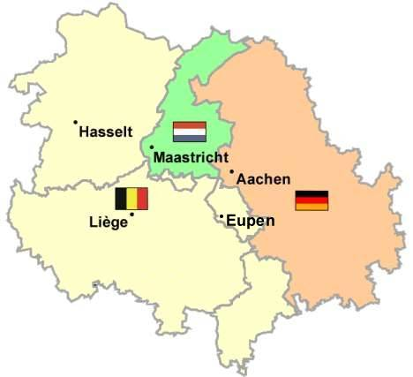
Euroregion - Meuse Rhine

Slide 22

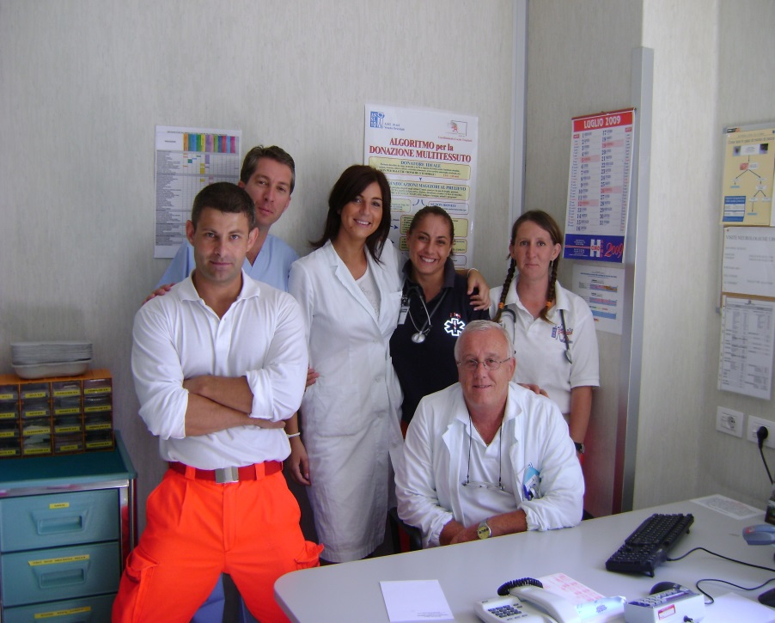

CONVENZIONI CON LE CASSE MUTUE TEDESCHE
From the Agreement …
…to its practical application
Notes:
22

Slide 23
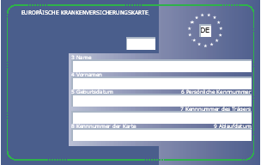
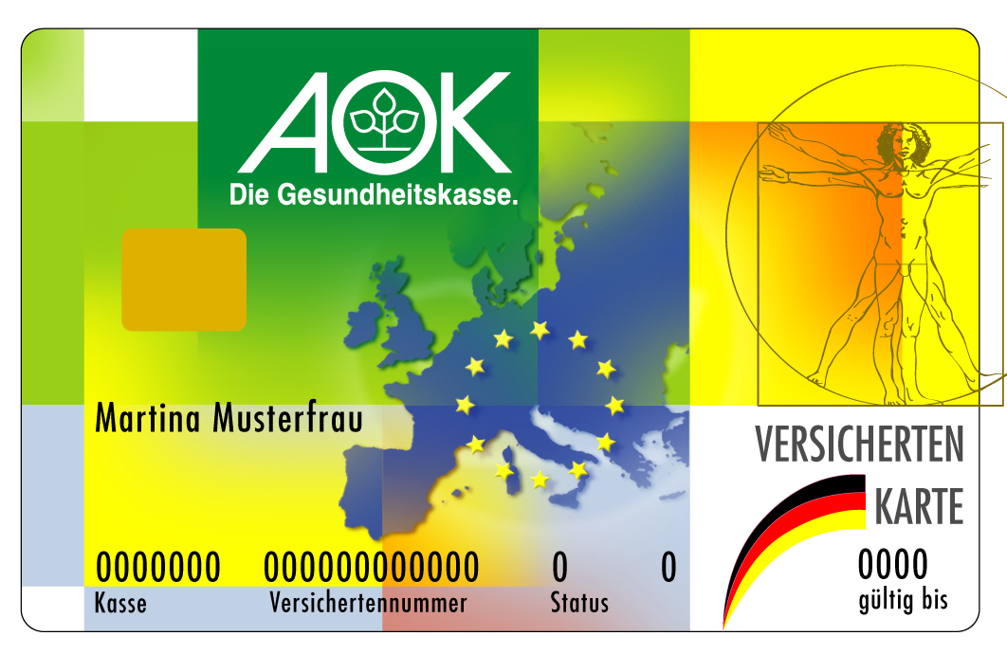
EuropeService means …
Goal: Access to healthcare services across the European Union like at home –
with the national health insurance card and the European health insurance card
GesundheitsCard Europe
Internet-based solution for Germans abroad
(authorisation to reimbursement)
Partnership of five AOKs with Techniker Krankenkasse (TK)
Insurance partners abroad in Austria, Belgium (CM), Italy, the Netherlands (CZ), Poland and in the Czech Republic
Development 2009: 10 Million towards 16 Million in insured people, negotiation with other interested partners in Germany
Notes:
This is what the EuropeService with the “Health insurance Card" looks like.
Above is the AOK-Card, in the middle a card of the Techniker Krankenkasse. Both offer this service.
The Health Card has the European Health Insurance Card on the back of the national health insurance Card.
The implementation and the application is based on internet solutions
For the Online Verification for German people abroad,
Permission of treatment and
Simplification of billing-processes between hospitals and health insurer in Germany.
The EuropeService is offered to 16 Million insured in Germany. Negotiation with other interested partners in Germany are running.

Slide 24
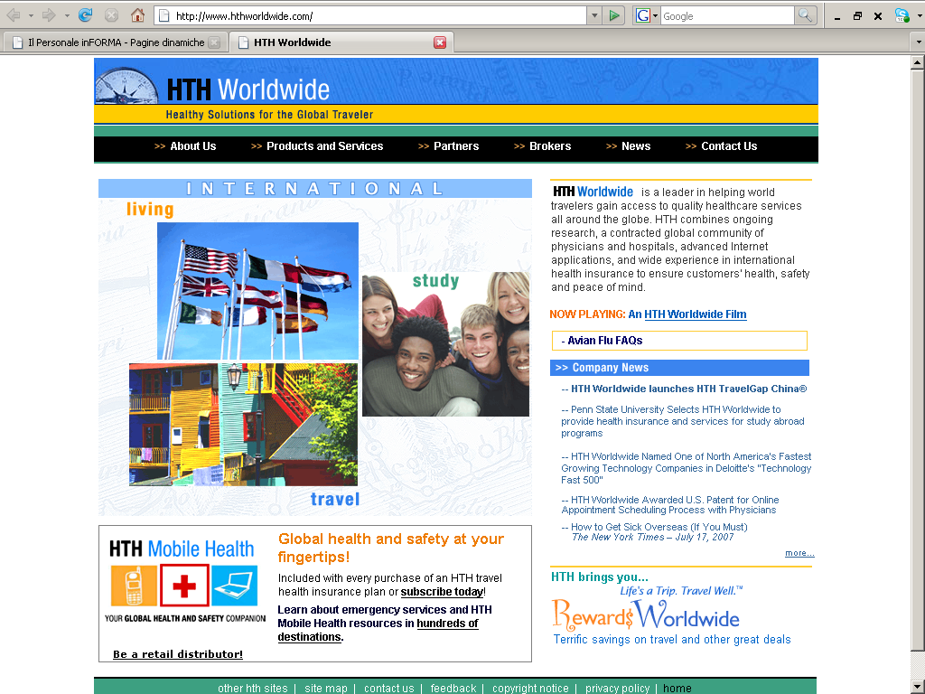

Slide 25
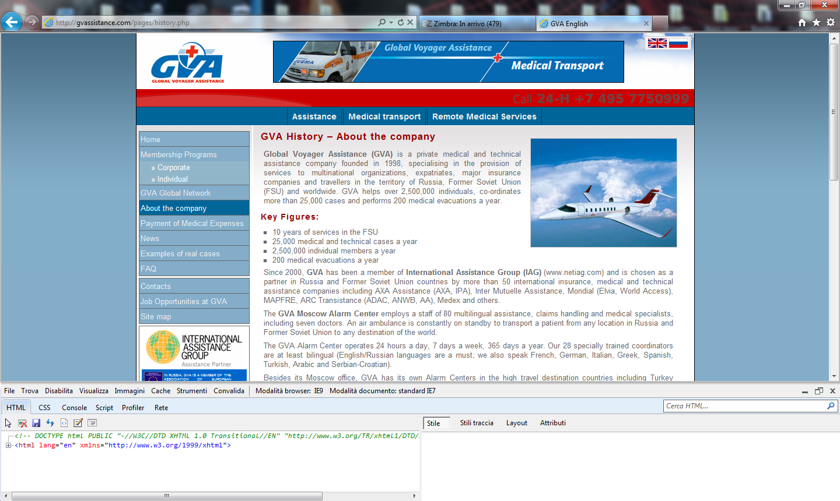
L. Bertinato, Regione Veneto, 2006

Slide 26
Domanda 5: La cultura organizzativa del sistema sanitario come si coniuga con quello della turismo?
Notes:
L.Bertinato-Palmanova 2011
26
L.Bertinato-Palmanova 2011
26

Slide 27
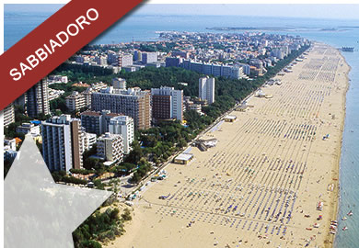
La medicina turistica permette di mettere in atto un approccio innovativo al fine di migliorare la sanità turistica e sostenere l’economia turistica locale

Slide 28
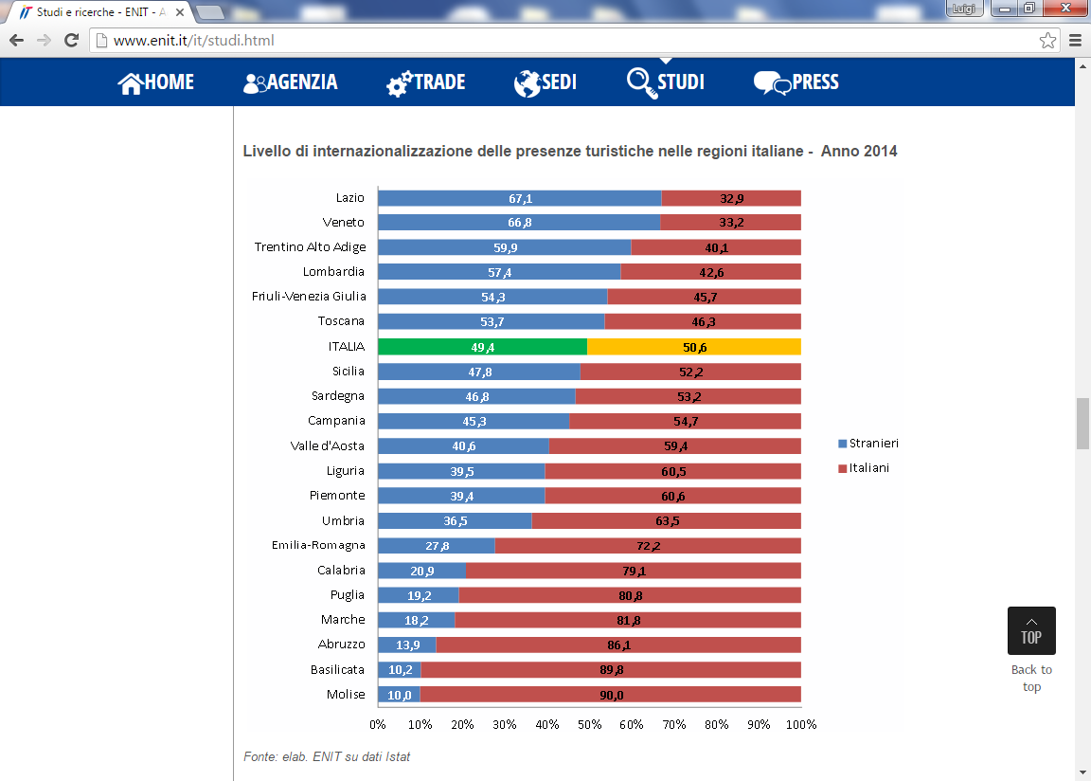

Poco meno di un miliardo di euro. È quanto il turismo straniero ha lasciato nel 2015 in Friuli Venezia Giulia,
secondo un'indagine della Banca d'Italia rielaborata da Ires Fvg

Slide 29
Domanda 6: Cosa richiedono le Casse Mutue per i loro assistiti ? Che organizzazione serve in ASL ?
Notes:
L.Bertinato-Palmanova 2011
29
L.Bertinato-Palmanova 2011
29

Slide 30
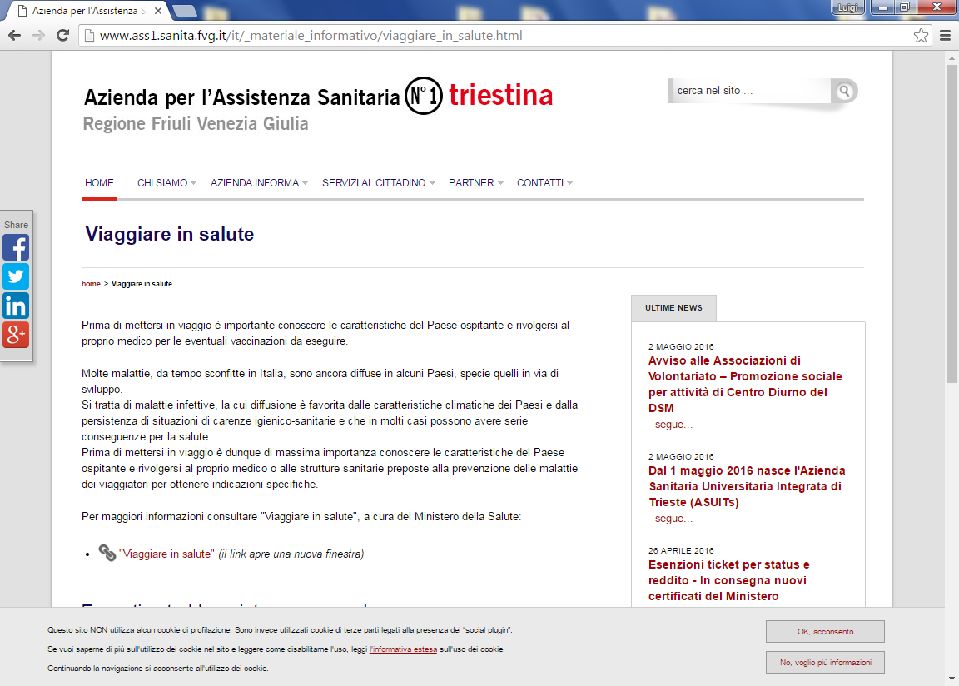
UFFICIO VACCINAZIONI INTERNAZIONALI

Slide 31
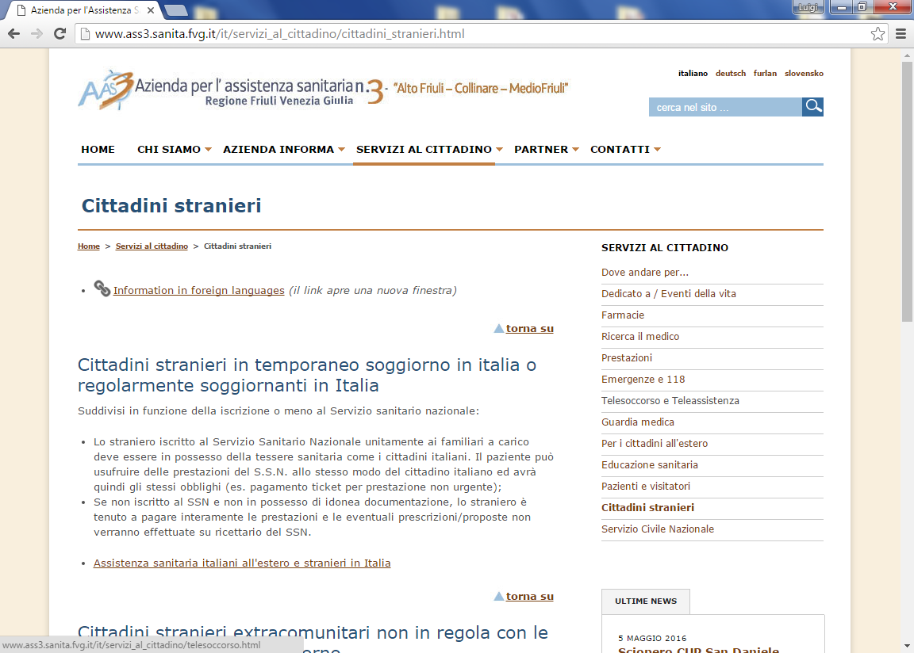
Ufficio Assistenza Italiani all’Estero e Stranieri in Italia

Slide 32
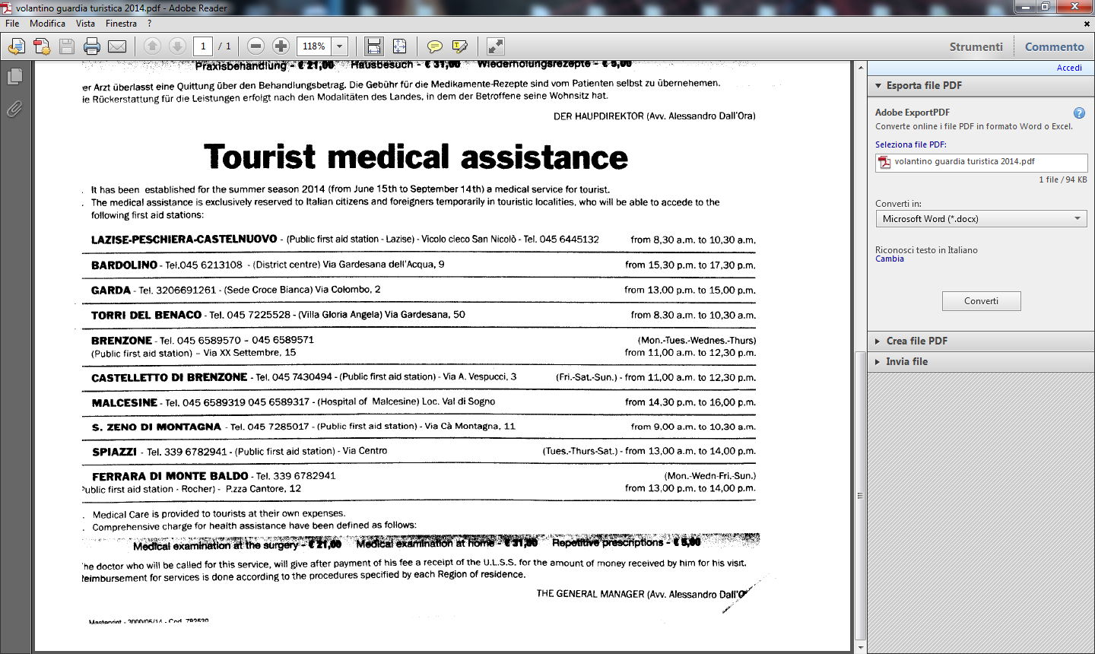

Slide 33
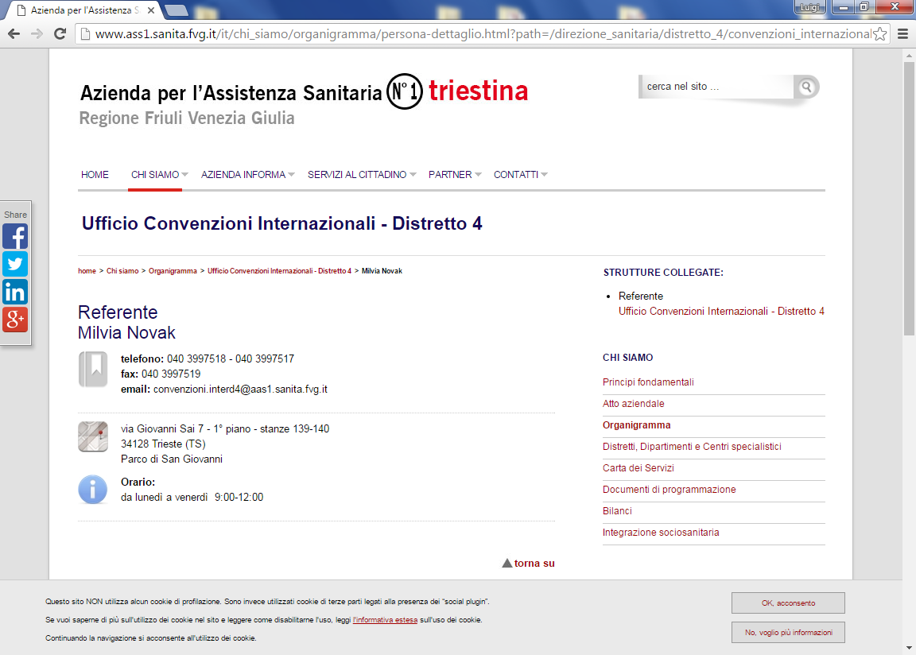
UFFICIO CONVENZIONI INTERNAZIONALI

Slide 34
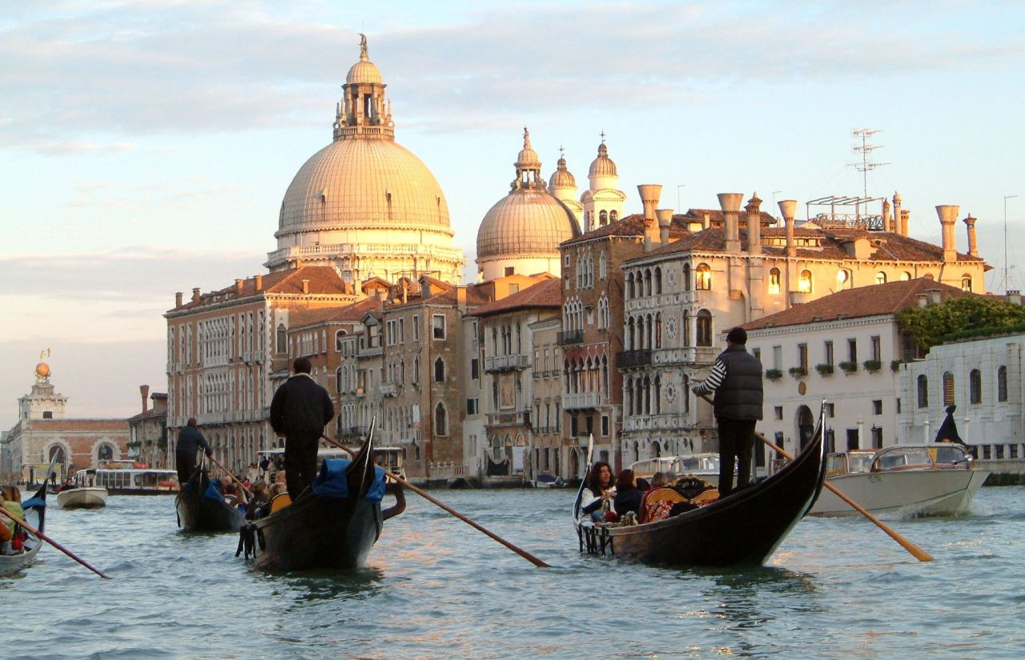

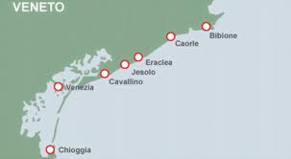
L’ Offerta Turistica per i Dializzati
italiani e stranieri in Ulss 10

Slide 35
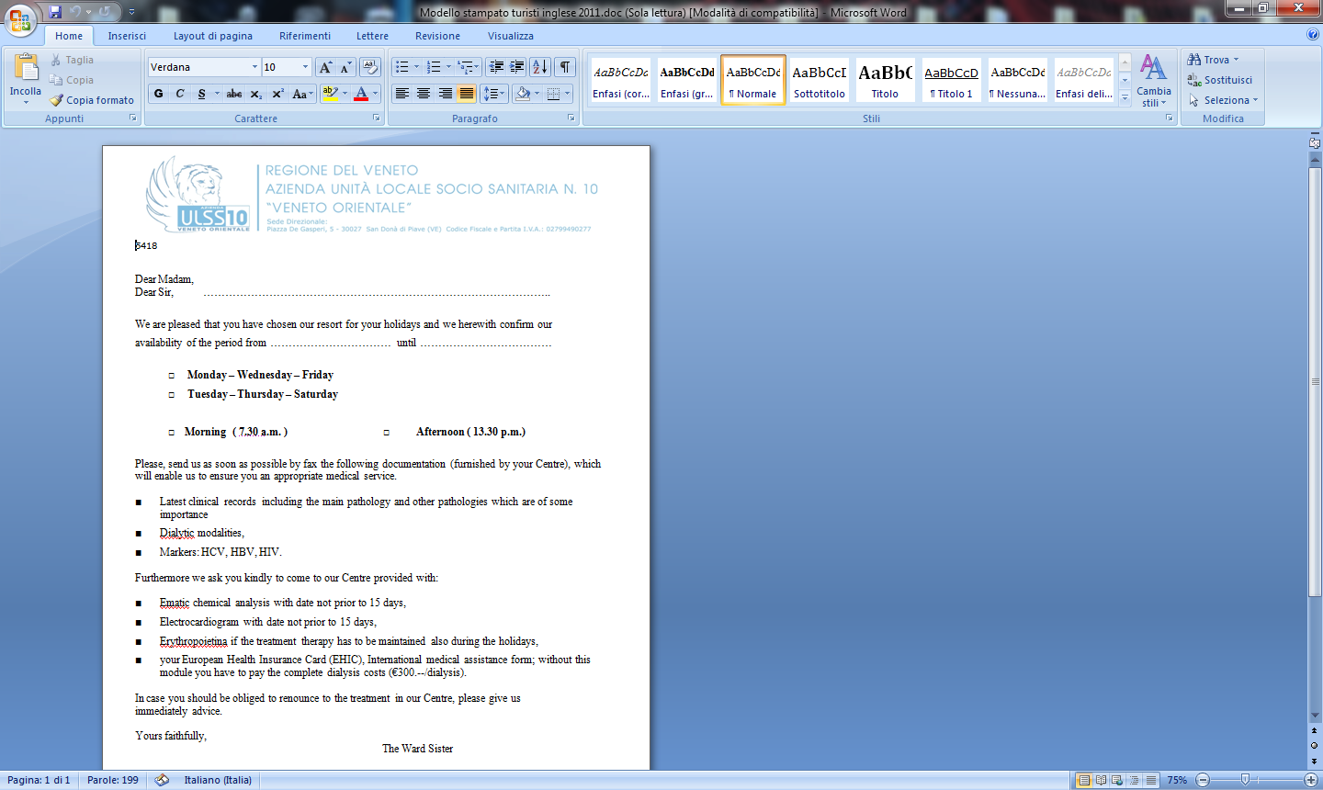

Slide 36


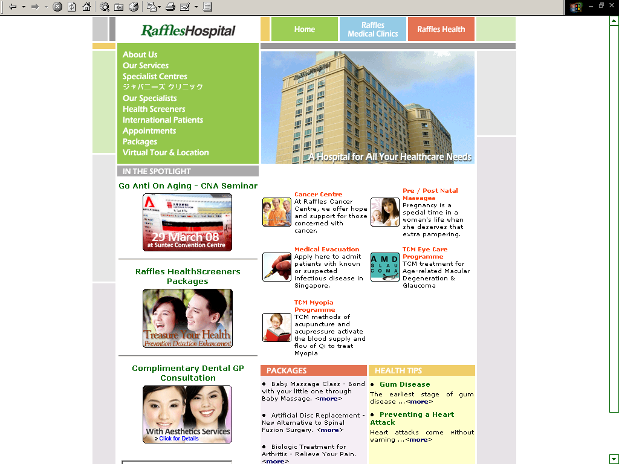
La crescita degli ospedali a “5 stelle”
Singapore
L. Bertinato 2016
36
Manila, Philippines

Slide 37

Sistema di offerta turistica e sanitaria in Regione:
La situazione attuale
Sistema
Socio Sanitario
Regionale
Sistema
Turistico
Regionale
EU
SPA
Notes:
37
Today in the public health sector the decisions are taken by MS and the EU, including decisions on strategies linked to reducing health inequalities. The majority of European Regions have experience in implementing activities or strategies mainly through Cross-border programmes. There is more room for communicating to the MS and to EU the results of best practice for addressing health inequalities.

Slide 38
Mobilità dei cittadini europei nella UE:
Le prospettive future per l’economia Regionale
EU
Sistema
Socio Sanitario
Regionale/
Privato Accreditato
Sistema
Turistico
regionale
SPA
L. Bertinato 2011
38
L. Bertinato
Notes:
38
Today in the public health sector the decisions are taken by MS and the EU, including decisions on strategies linked to reducing health inequalities. The majority of European Regions have experience in implementing activities or strategies mainly through Cross-border programmes. There is more room for communicating to the MS and to EU the results of best practice for addressing health inequalities.

Slide 39
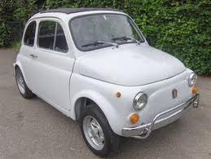

Le Sfide delle ASL sulla Mobilità Internazionale dei Pazienti,affinché questa non sia un onere finanziario e possa trasformarsi in un beneficio ……
…forse dipendono anche dalla Programmazione Illuminata !
Ferrari Atto Aziendale
Fiat 500 Atto Aziendale

Slide 40

Dice il saggio:
Colui che non prevede le cose lontane … si espone ad infelicità ravvicinate
(Confucio)
40
Notes:
40

Slide 41
Grazie per la vostra Attenzione !
lbertinato@ulss20.verona.it

Slide 42
Mobilità attraverso la Forma Diretta
Autorizzazione Centro Riferimento Regionale
2) Addebito da UK, Reg.883/04 e 987/09, Modello E125
3) Fattura da NHS, via NSIS al SSN, dal SSN al SSR Veneto,,fattura alla Ulss 22, controllo e trasmissione al SSR e da qui al SSN che liquida con i fondi della compensazione internazionale.

